Slide 1
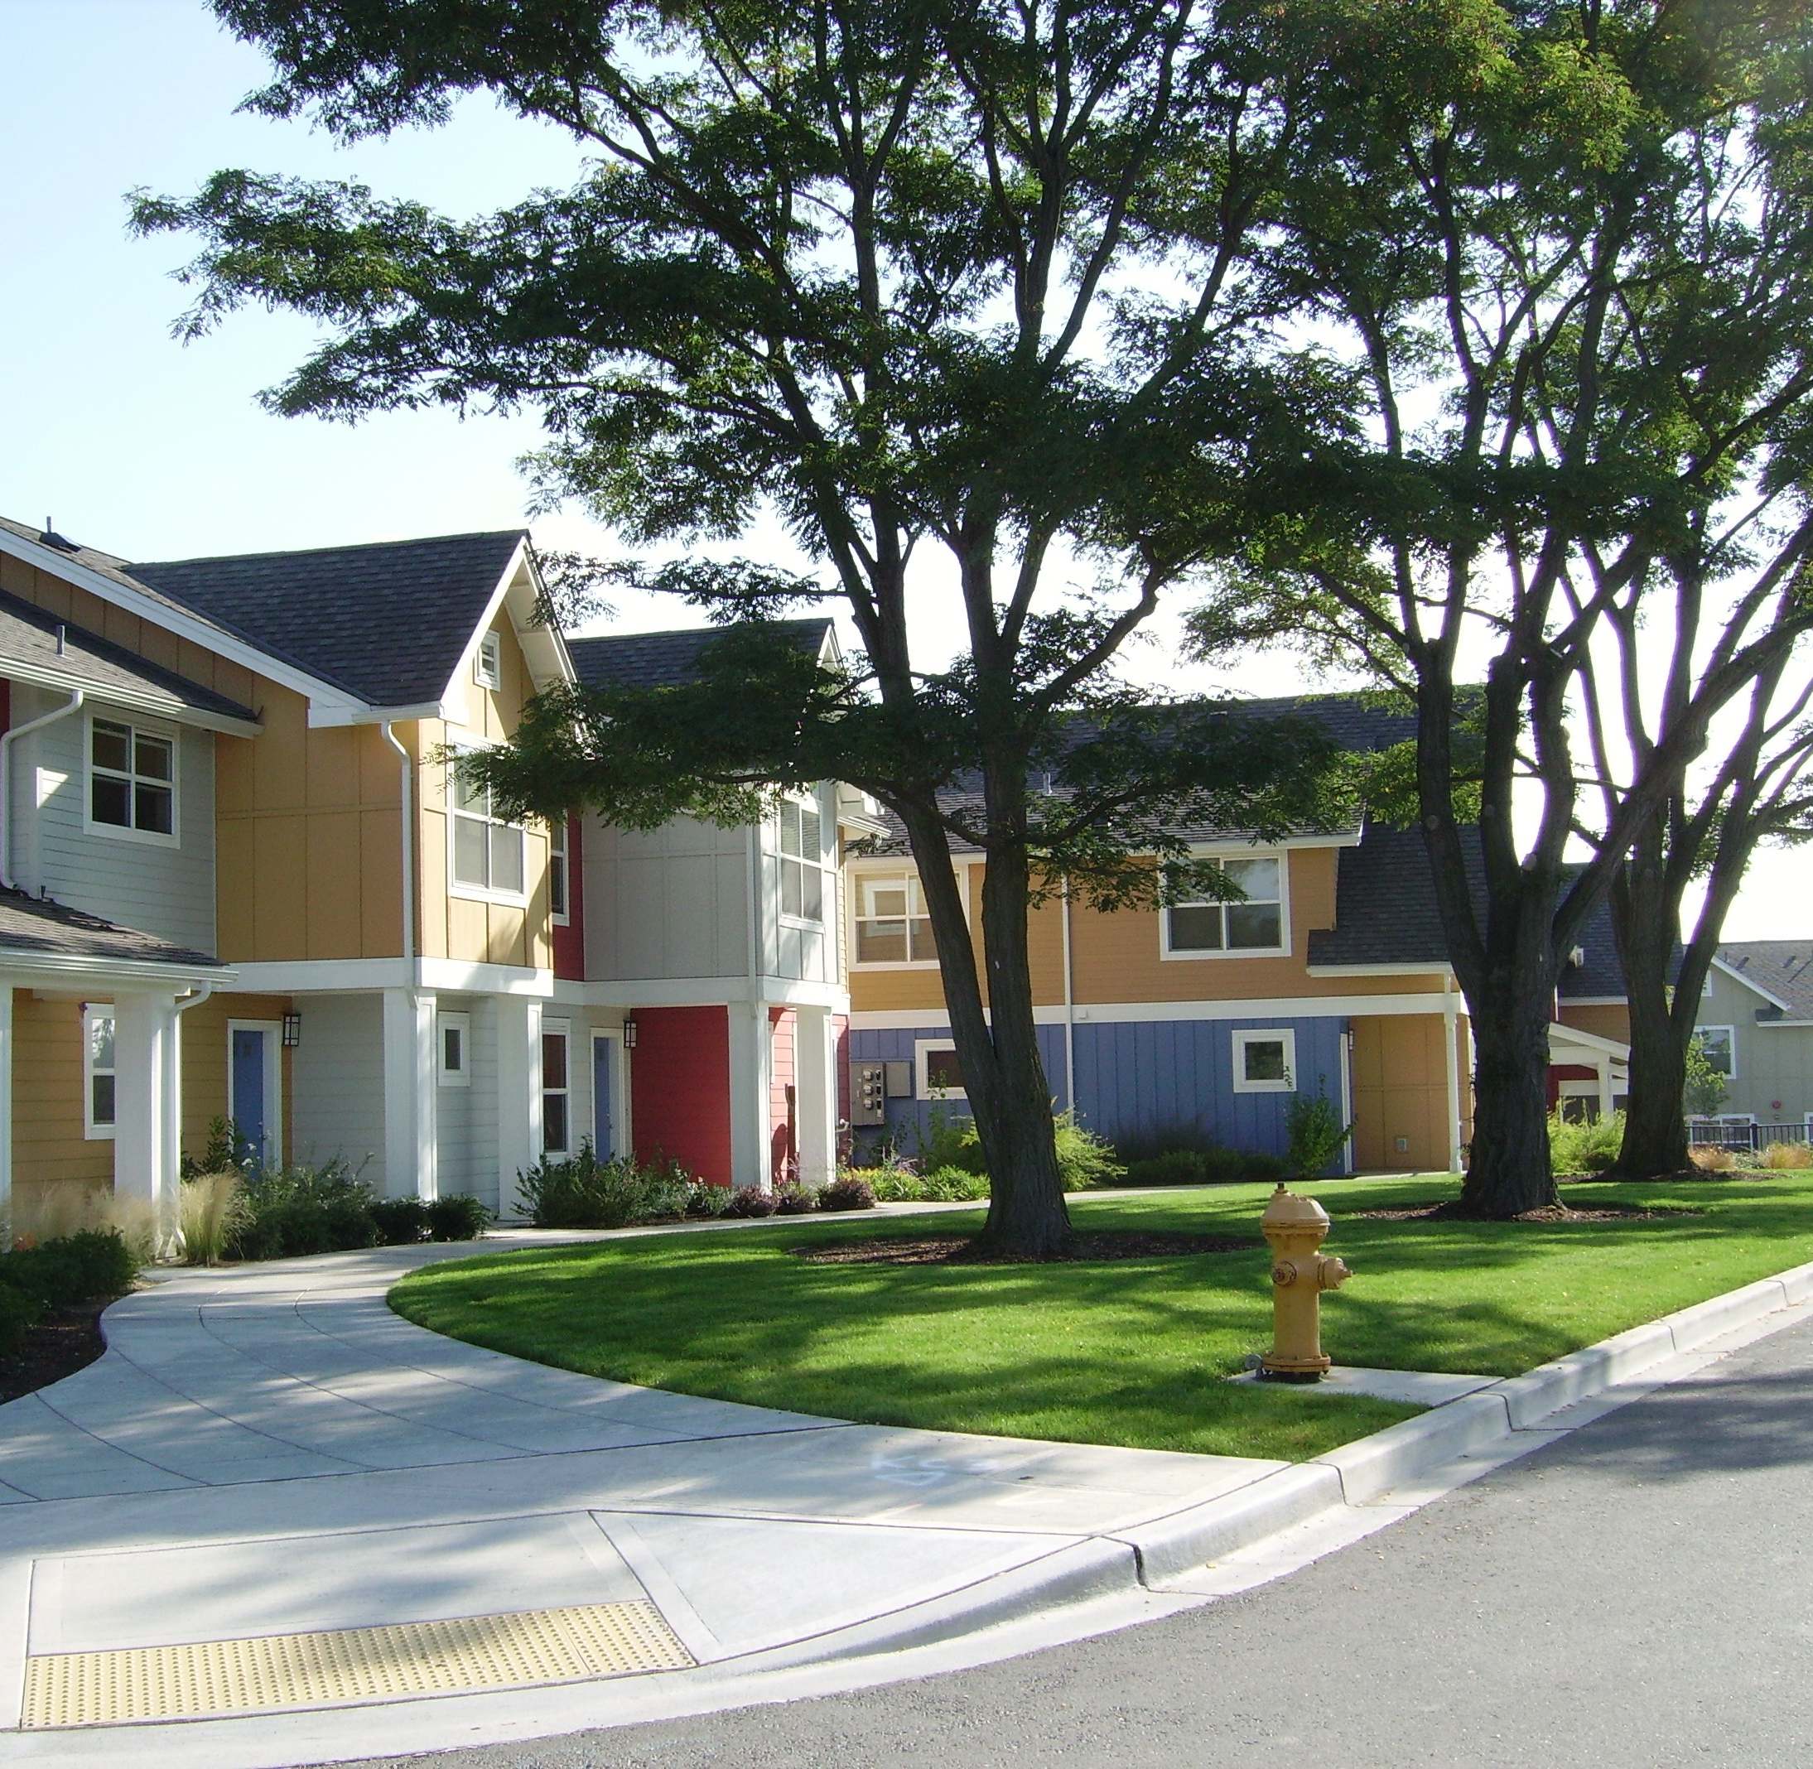
KING COUNTY HOUSE SALE ANALYSIS
Helping a construction/real estate company in King County know which house features would likely increase the price of a house
Data used: kc_house_data.csv

Slide 2
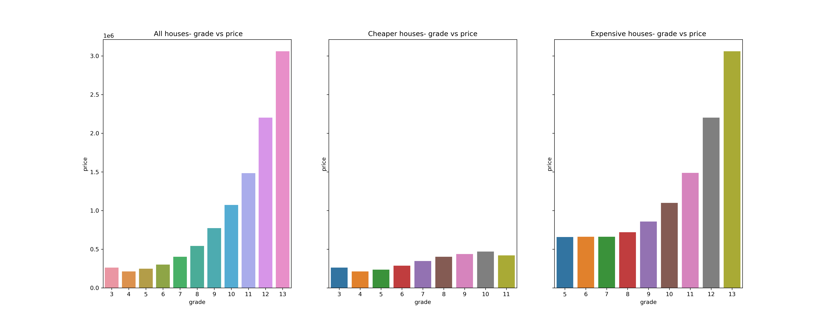
House grading vs price

Slide 3
From the analysis:
It showed that overall there was an increase in price as the house grading increased .
However, for cheaper houses (price <540,000),there was a consistent increase in price from grade 4 onwards upto grade 10. Its surprising that the price fell again at grade 11 and also the price was higher at grade 3 than 4 or 5.
For the expensive houses(price >=540,000), the change in price is quite subtle at first but starts rising by huge margins from grade 9
Point to note is that expensive houses grade starts at 5 and goes all the way to 13,while cheaper ones are from 3 to 11.It could be one of the reasons why the expensive ones are more expensive

Slide 4
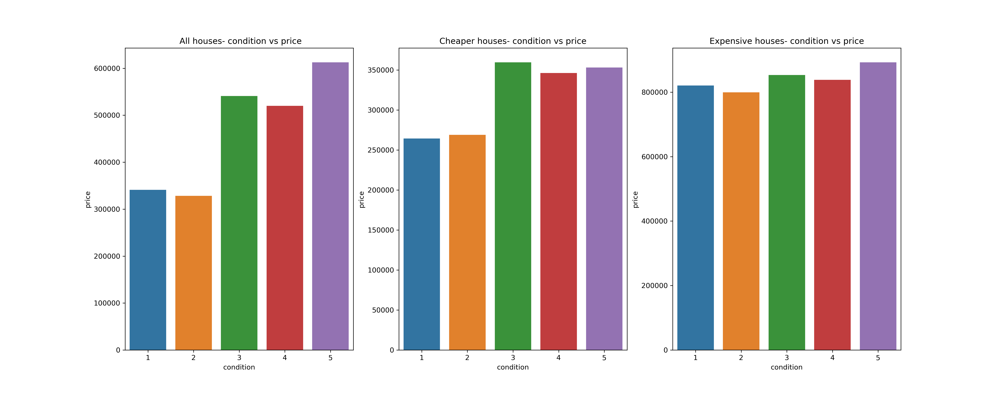
Condition of the house vs price

Slide 5
Condition vs price
Overall, good condition equals good prices
For cheaper houses, condition 1 and 2 don't fetch good prices. But from 3 onwards, the prices vary just by a bit.
For the expensive ones, the relationship is quite mixed. Although houses with condition 5 fetch the better prices, the other conditions are also not far off. It could be that there are just subtle changes in the house based on those conditions, that is, the difference in the way the houses look is not so huge for the different conditions

Slide 6
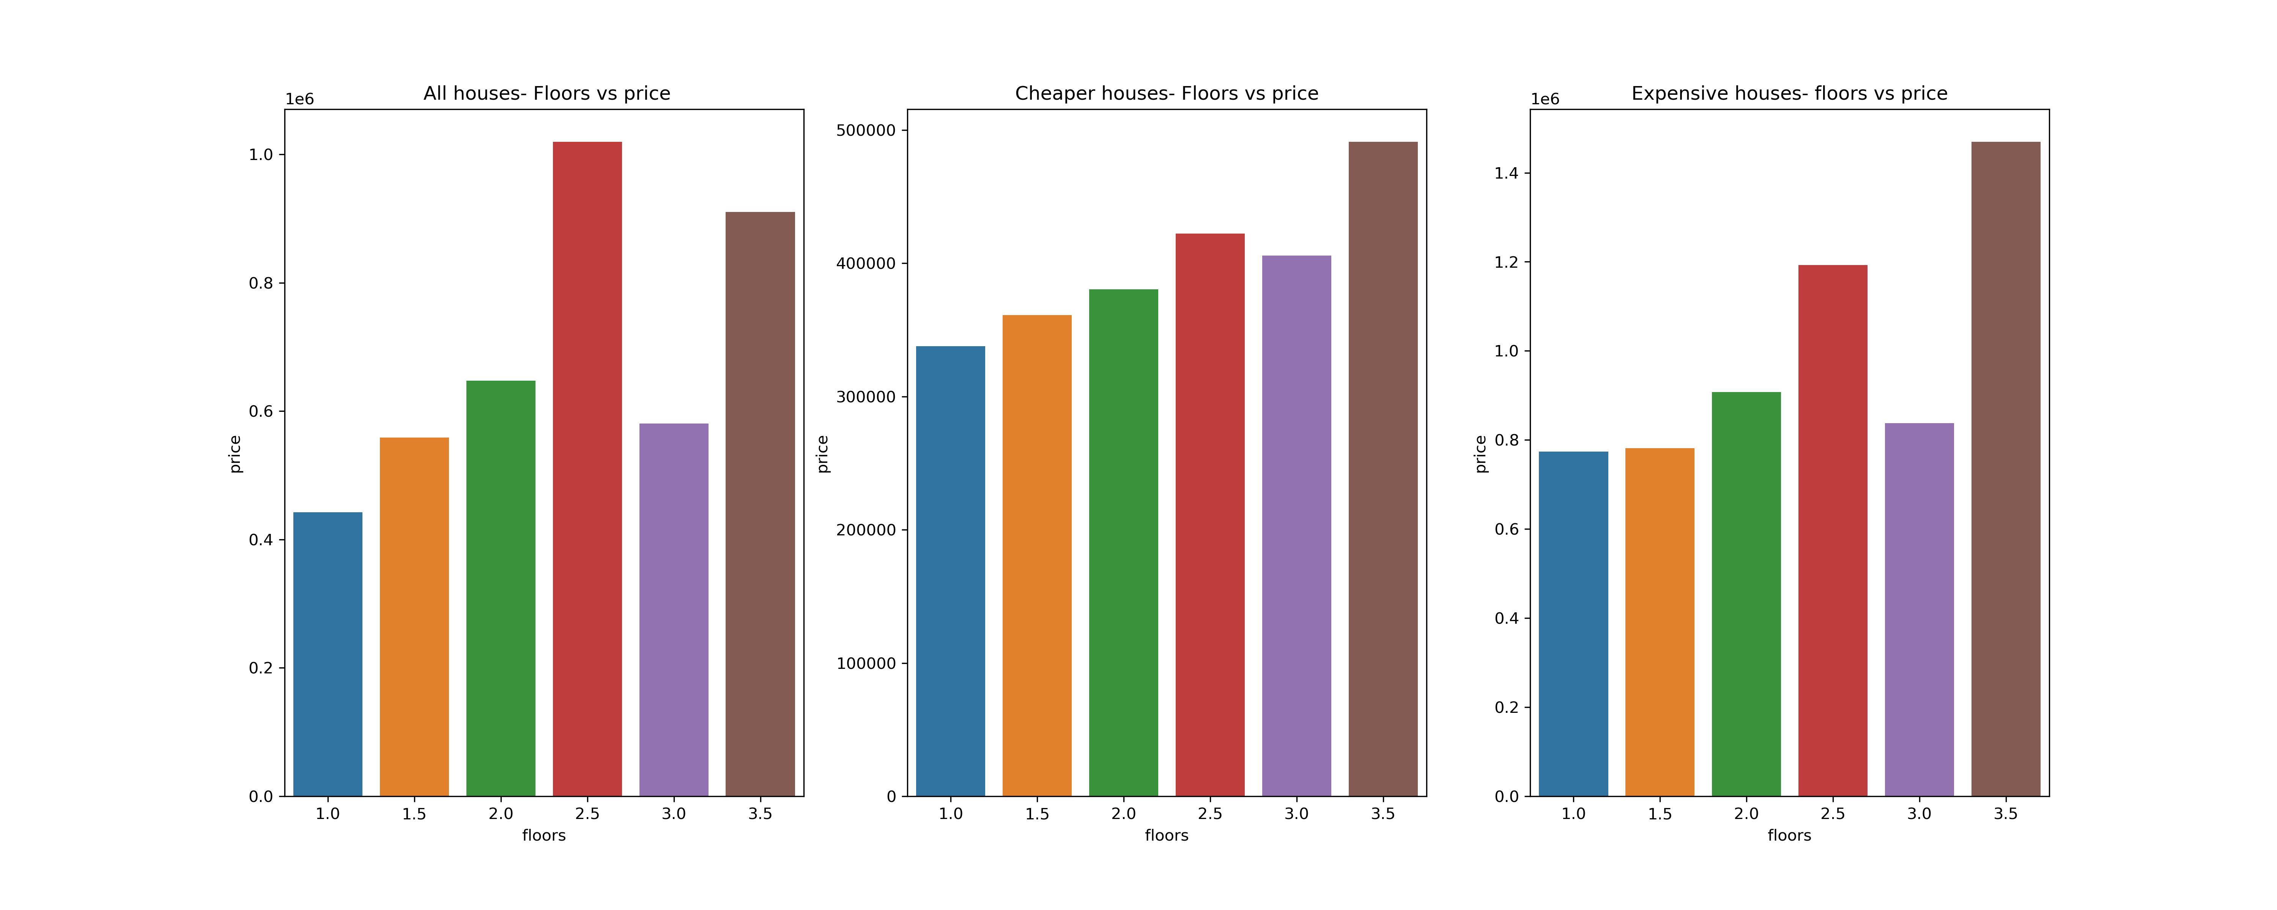
Number of floors vs price

Slide 7
Price given number of floors
For some reason, the price for both the cheaper and expensive houses falls when the house has 3 floors, but it otherwise increases as the number of floors increase

Slide 8
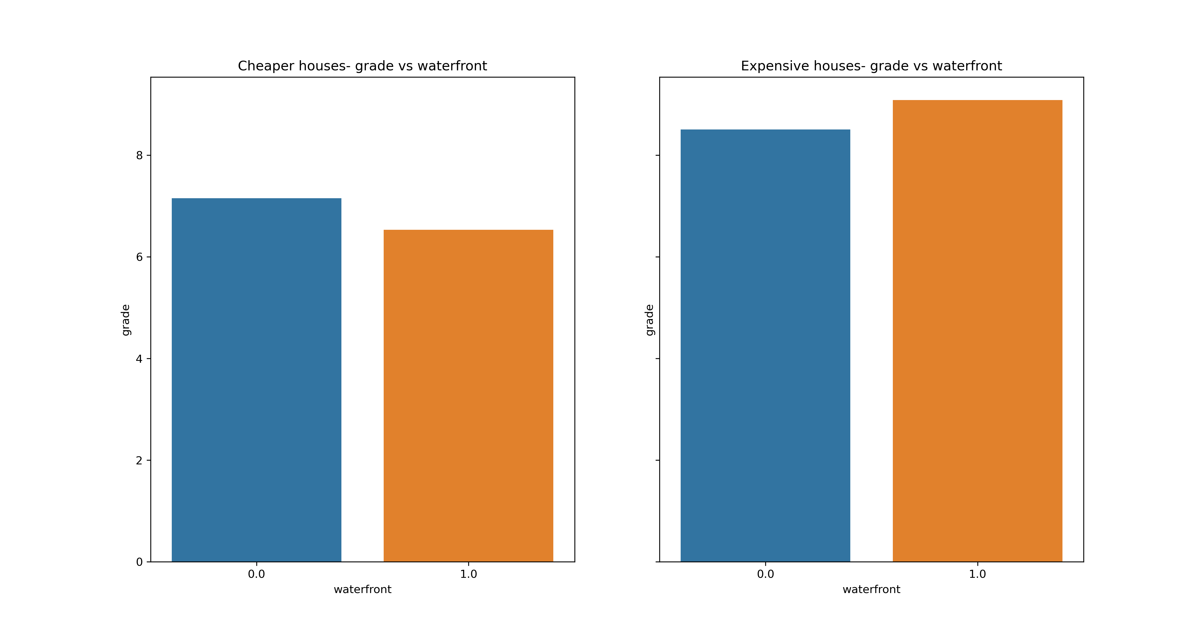
Presence of a waterfront
Surprisingly, cheaper houses that had a waterfront had lower grade
It was opposite for the more expensive houses

Slide 9
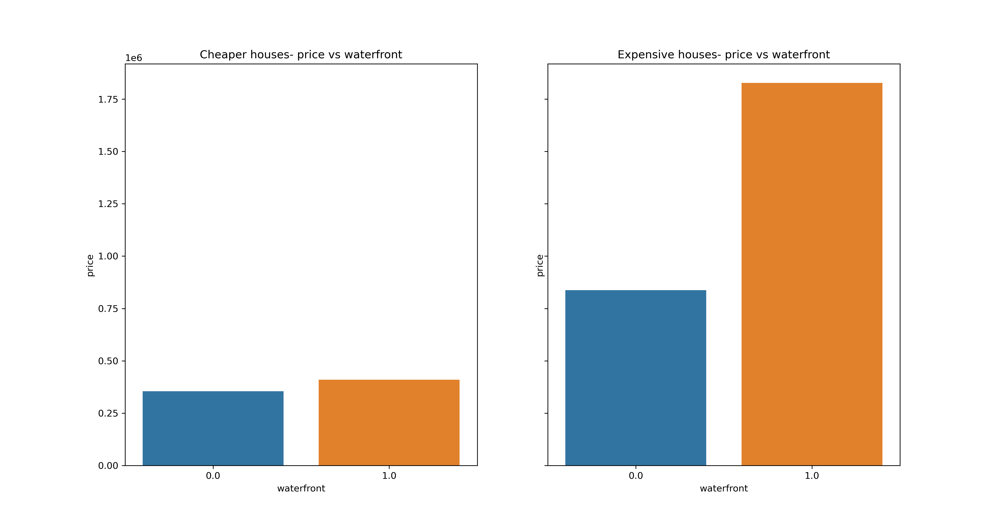
Waterfront vs Price
However, presence of a waterfront showed better price. Its more prominent for the expensive houses though

Slide 10
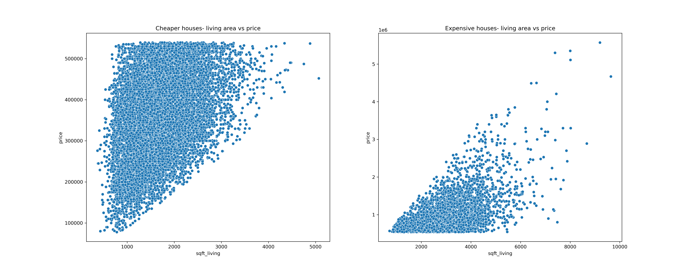
Area of house vs price
There was a very strong linear relationship between the area of the house and the price for the cheaper houses. A small change in area had a huge change in price
For the expensive houses, there is also a linear relationship, though not as strong

Slide 11
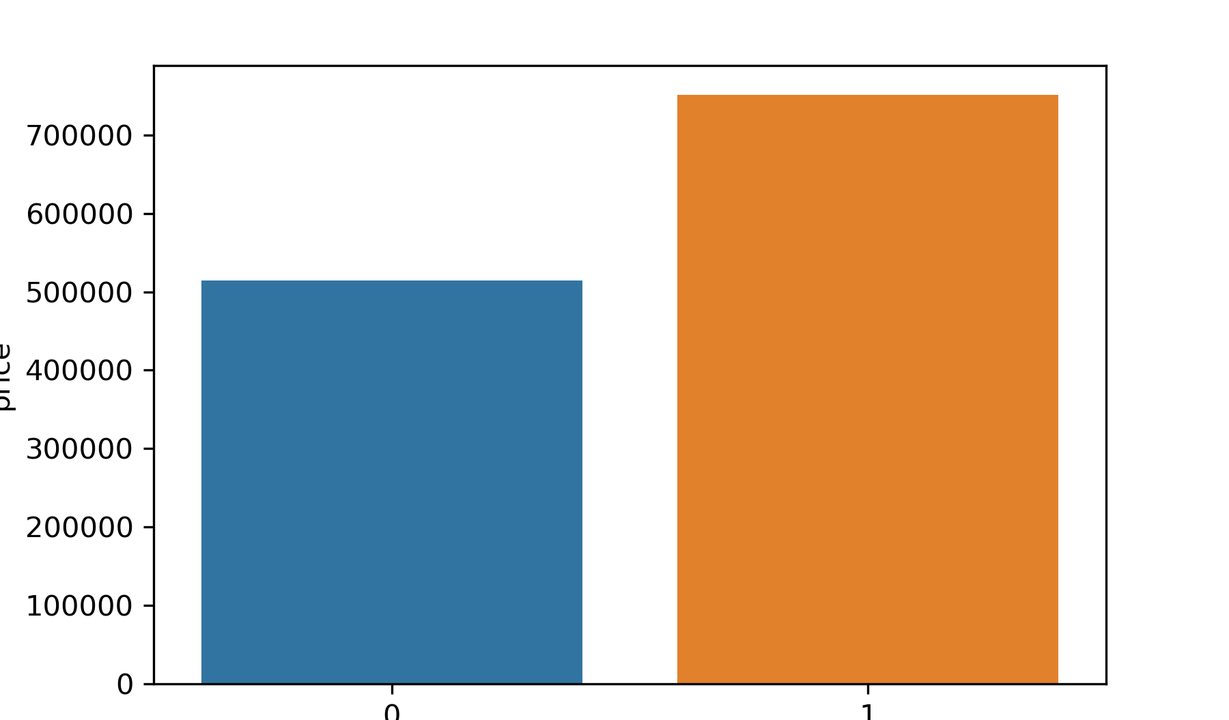
Renovations vs price
Renovations definitely increase the price of the house

Slide 12
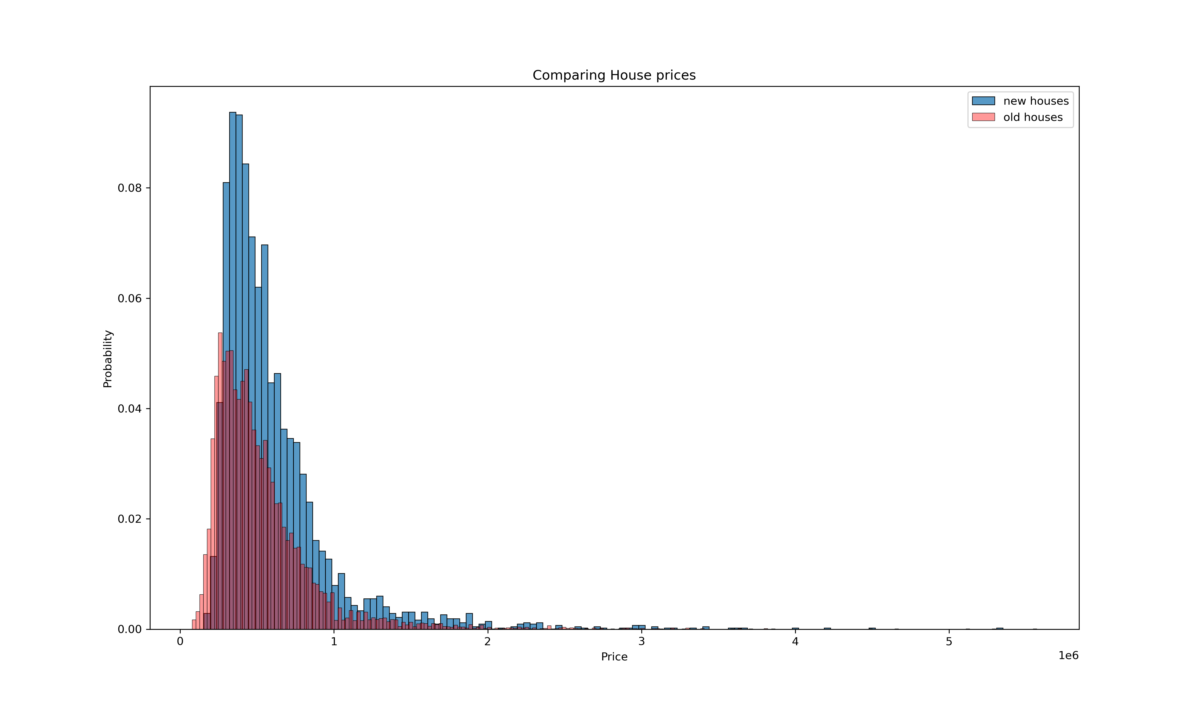
Older house(>12 yrs) vs newer houses price
For the same price range, there was a preference for newer houses than older houses

Slide 13
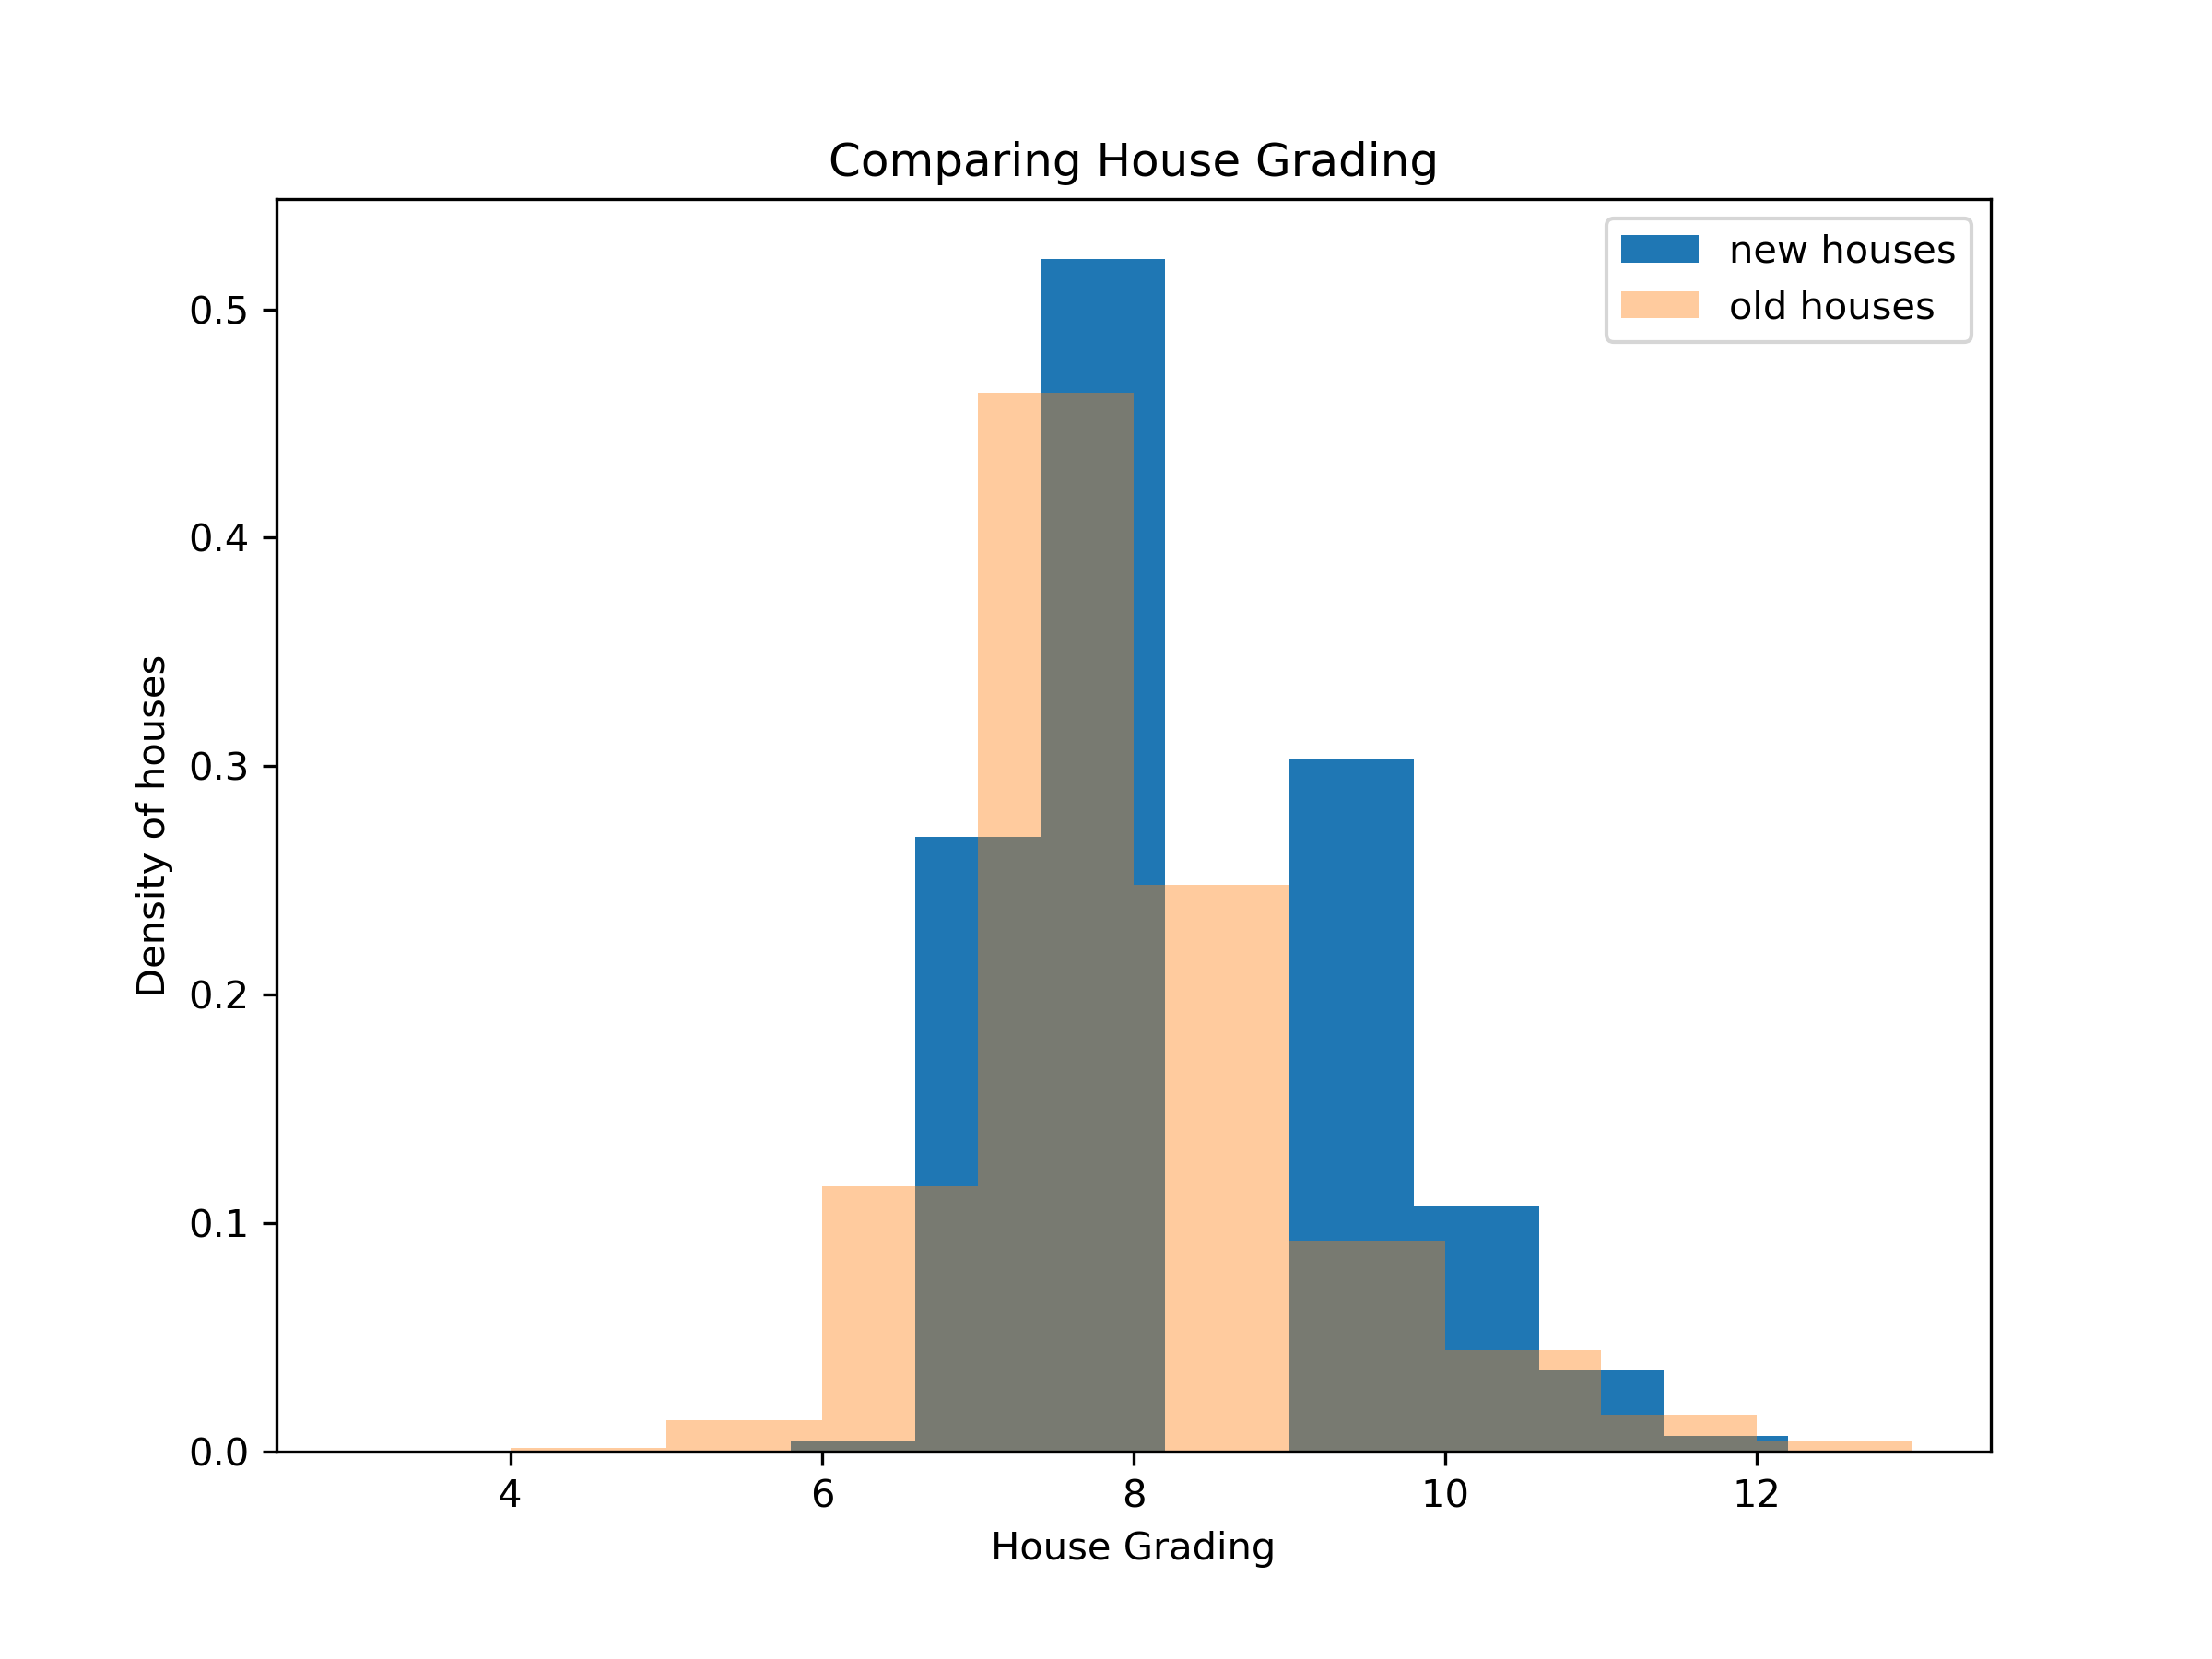
Grading for newer vs older houses
The preference for the newer houses that was seen above could be from the fact that newer houses had better grading than older houses.
Newer houses were graded from 6 onwards with many at 7.5-8.3 and 9-10, while older ones were starting from 5 with lots of them at 7-9

Slide 14
Statistical inference
Dropping collerated features and doing inference , the features that most positively influenced the price were:
Sqft_above- the area above the basement
grade
House Location(latitude)
waterfront
Sqft_basement( size of the basement)
The features that most negatively influenced the price were:
Number of bedrooms
Year the house was built

Slide 15
Recommendations
The company should work on getting good grades for the houses( 8 upwards)
If there is a waterfront, its more economical if the house is expensive( above 540,000)
Aim for house condition of atleast 3
Cheaper houses have more returns per unit increase in sqft living area. Invest more in those
Renovations increases price, if a renovation is due, it should be done

Slide 16
More analysis that can be done
Perform more research why the price of the houses that have 3 floors dip
Why the grade for cheaper houses that have a waterfront is lower than those without
How significantly location affects the price of house

